Slide 1
Shell Bootcamp 2024 3 Reflections for Week 1<>
Kabir Dhruw
Date : 06-Sept-2024

Slide 2

About Me
Chase excellence, Not perfection.

Slide 3

My learnings from this week!

Slide 4
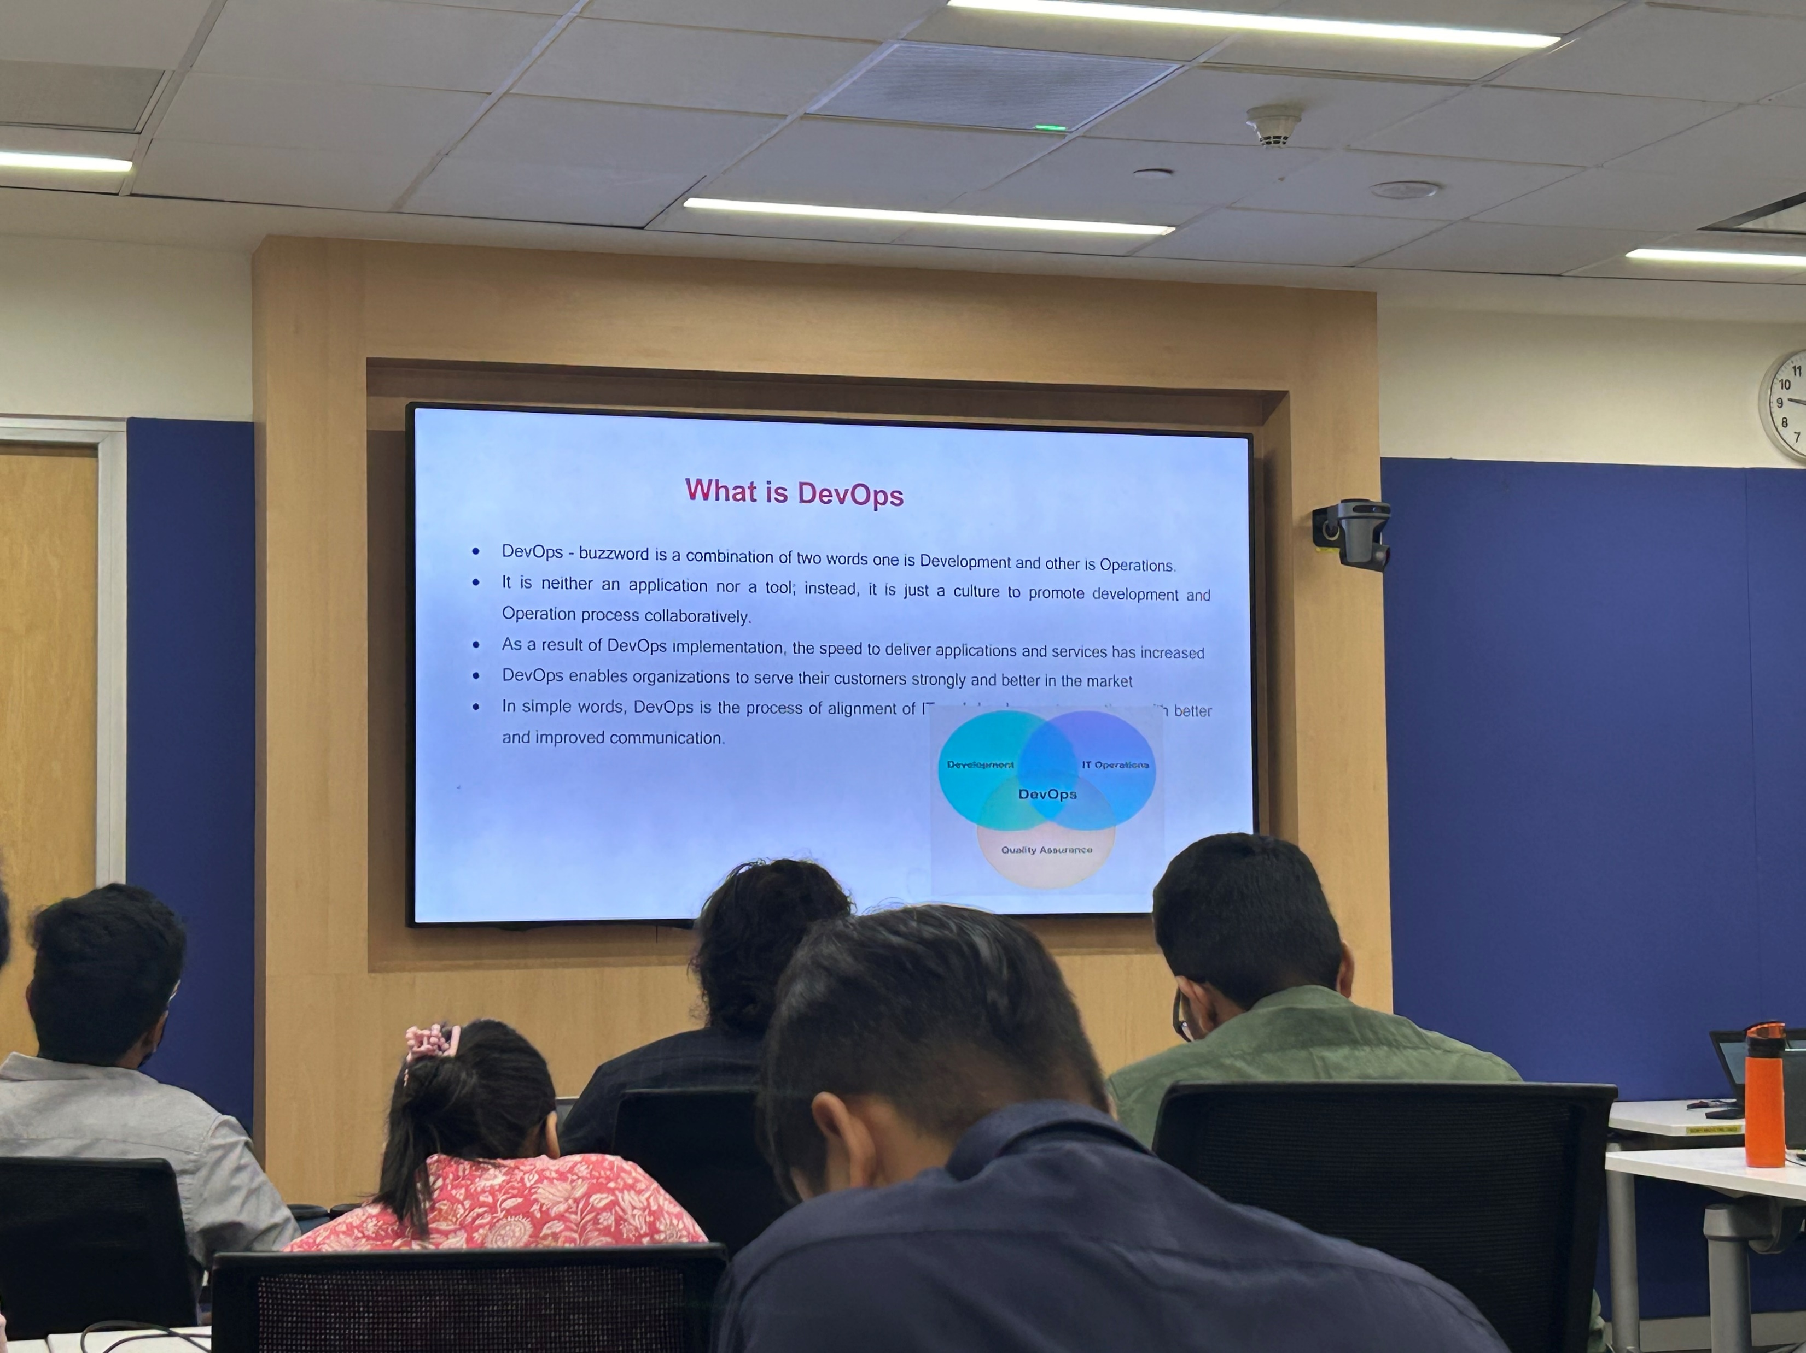
Learning 1 |
Business analysis is crucial for identifying business needs, solving problems, and ensuring successful project outcomes by bridging the gap between stakeholders and technical teams.
The Software Development Life Cycle (SDLC) is essential for planning, creating, testing, and deploying software efficiently, ensuring quality and meeting user requirements.

Slide 5
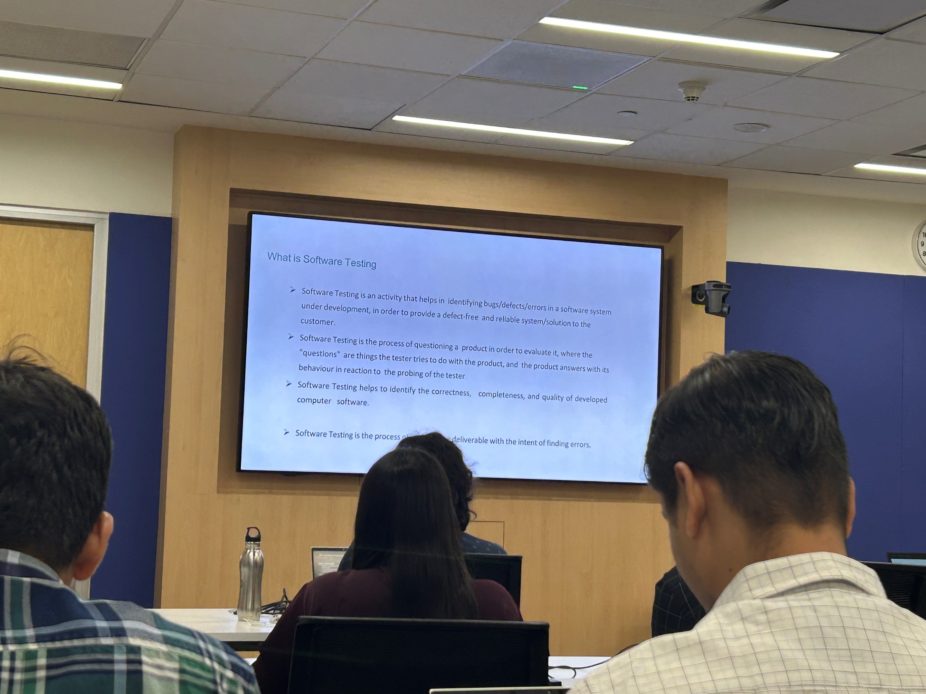
Learning 2 |
Agile methodology is vital for delivering high-quality software quickly and efficiently through iterative development, continuous feedback, and collaboration among cross-functional teams.
Scrum is essential for managing complex projects by promoting iterative progress, transparency, and collaboration through defined roles, events, and artifacts.

Slide 6
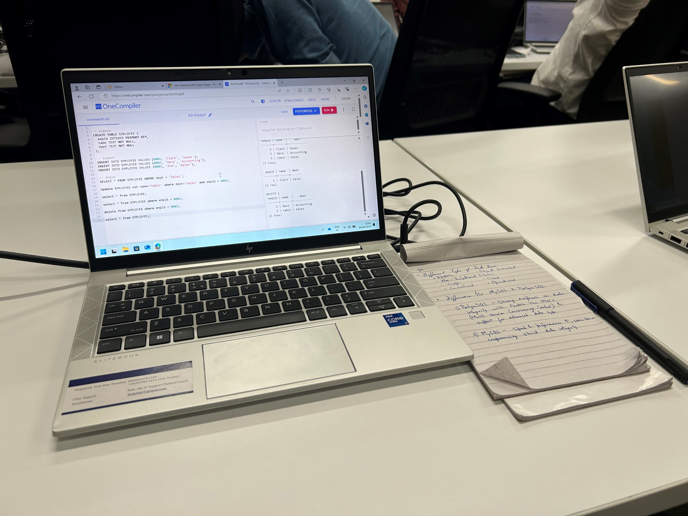
Learning 3 |
The Software Testing Life Cycle (STLC) is crucial for ensuring software quality by systematically planning, designing, executing, and evaluating tests to identify and fix defects early in the development process.
DevOps enhances collaboration between development and operations, ensuring faster and more reliable software delivery
A Database Management System (DBMS) is essential for efficiently storing, retrieving, and managing data, ensuring data integrity and security.

Slide 7

Relevance of learnings for my organization

Slide 8
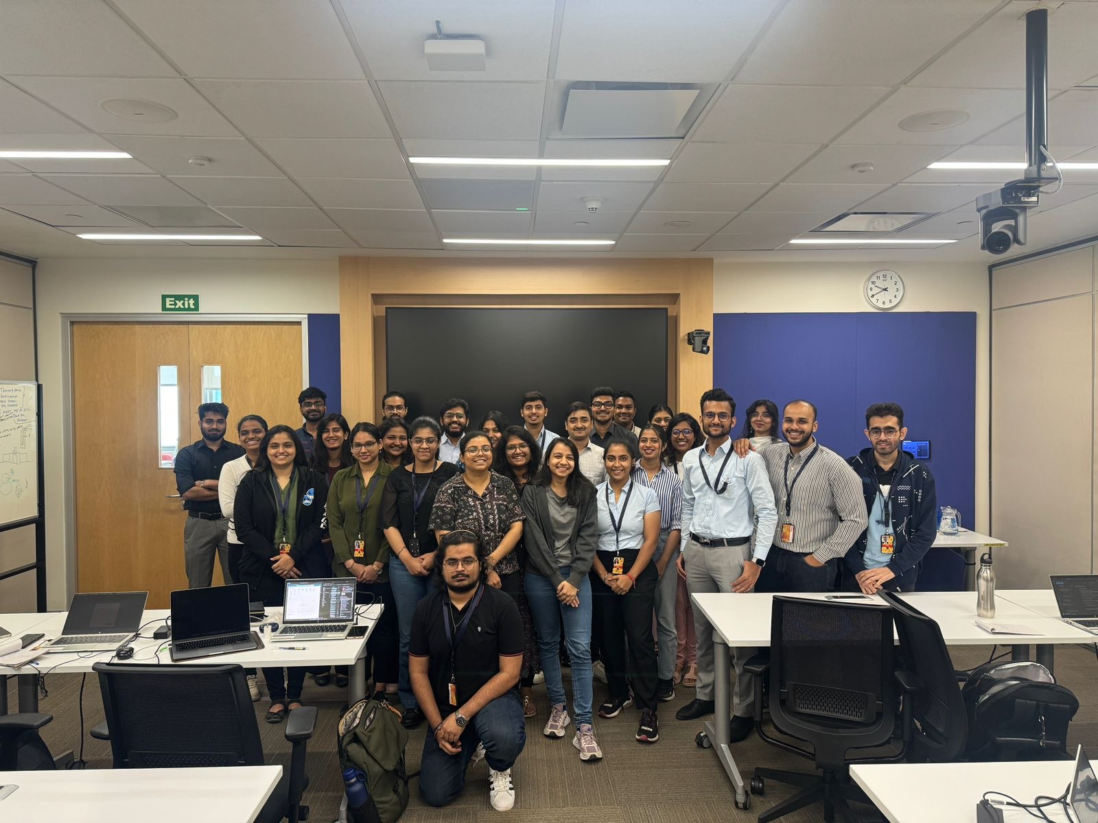
Learning 1 | Relevance for Shell
Combining Business Analysis, SDLC, Agile, Scrum, STLC, DevOps, and DBMS can significantly benefit an organization by ensuring efficient project management, high-quality software delivery, and robust data management.
This integrated approach fosters collaboration, accelerates development cycles, enhances software quality, and ensures data integrity, ultimately driving business success.

Slide 9
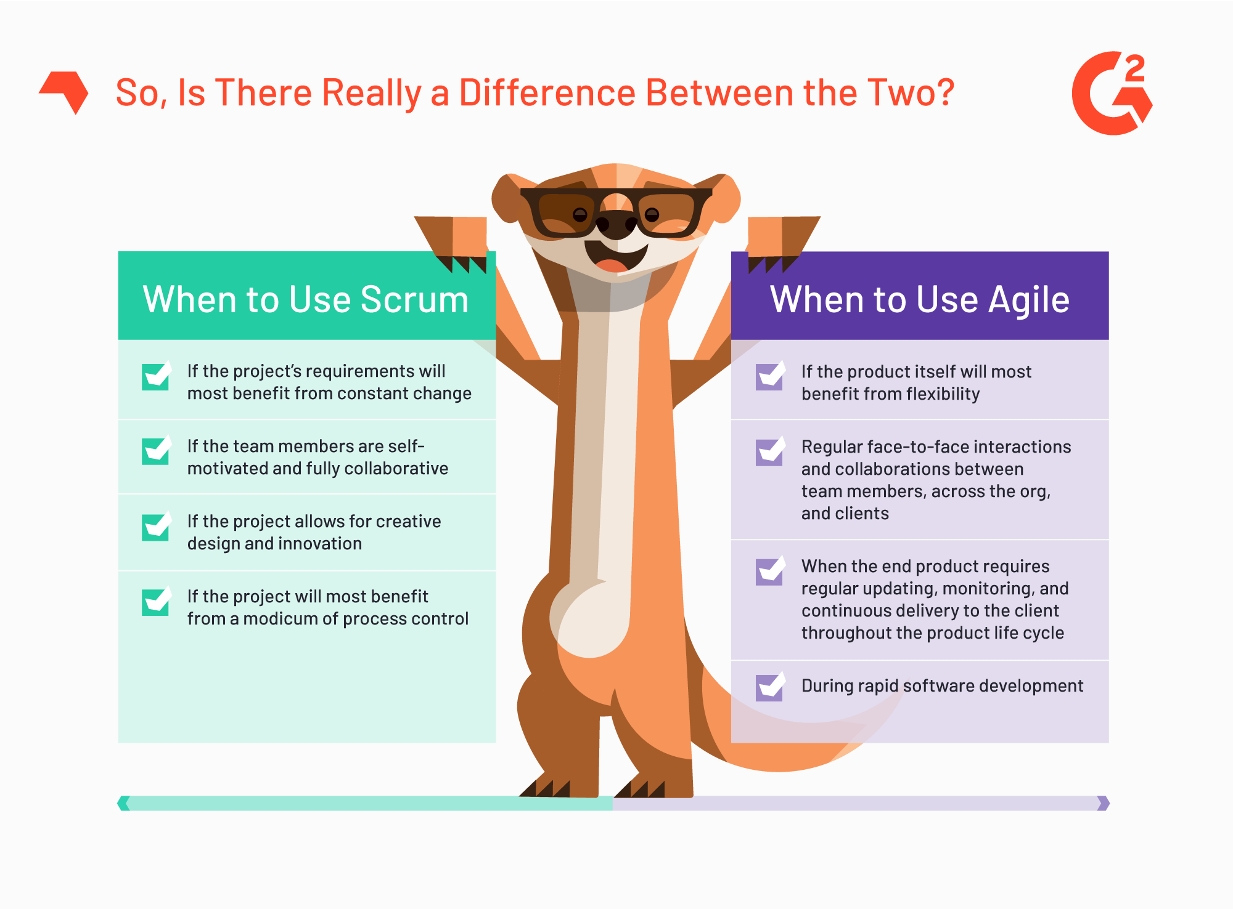
Learning 2 | Relevance for Shell
Agile and Scrum methodologies allow teams to quickly adapt to changes in requirements or market conditions, ensuring the organization remains competitive.
Regular testing (STLC) and continuous integration (DevOps) help identify and mitigate risks early in the development process, reducing the likelihood of costly errors.

Slide 10
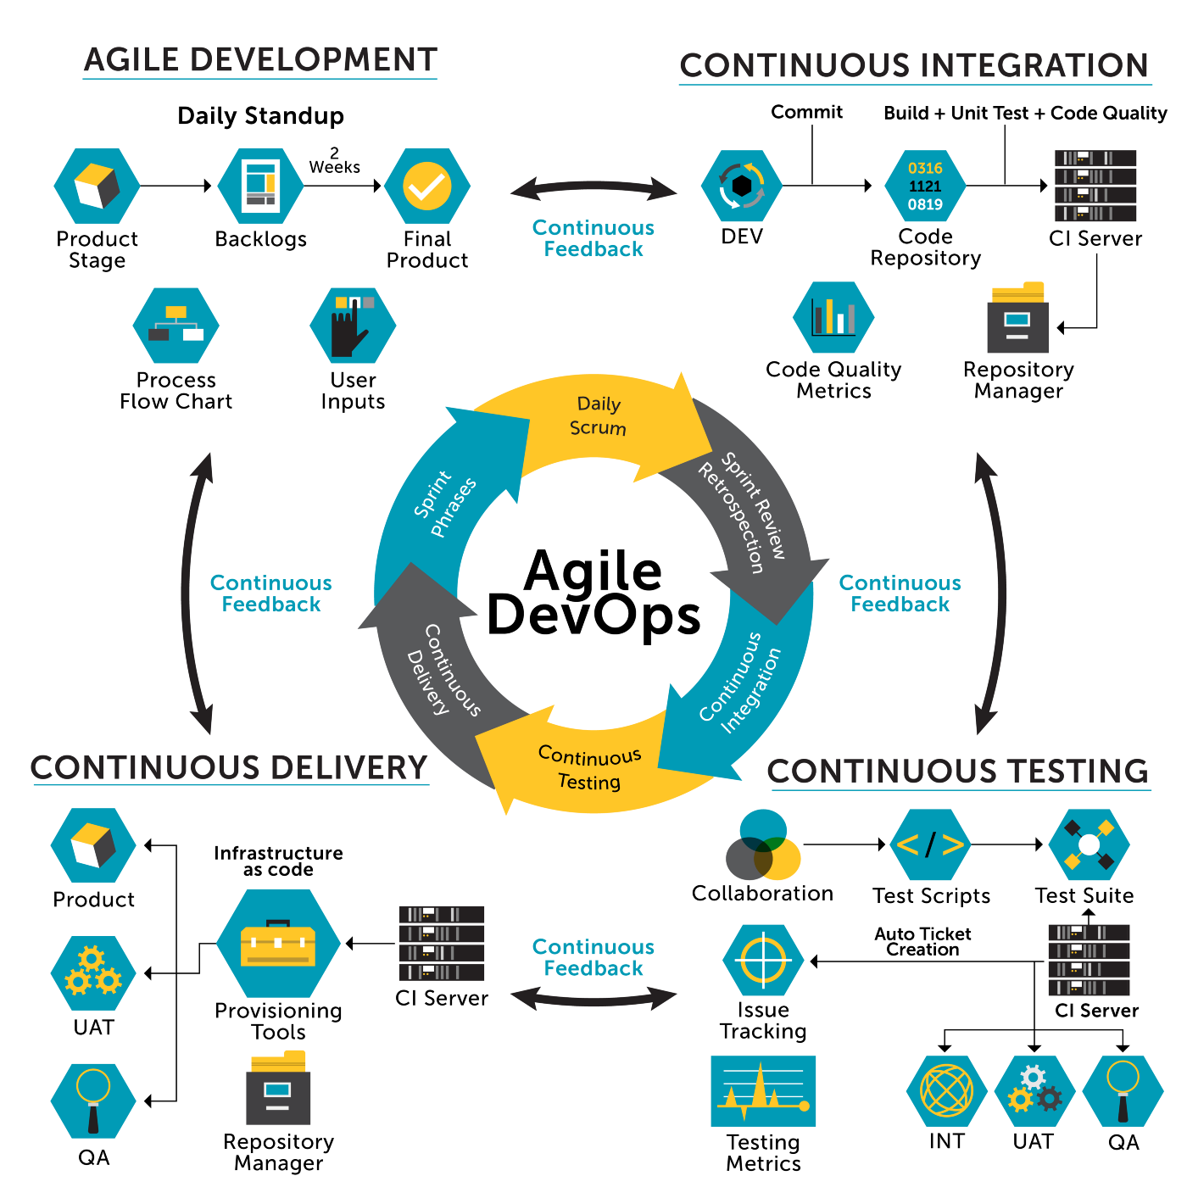
Learning 3 | Relevance for Shell
Efficient project management (SDLC) and streamlined processes (DevOps) ensure optimal use of resources, reducing waste and increasing productivity.
A robust DBMS supports the organization’s data needs as it grows, ensuring that data management processes can scale with the business.

Slide 11

Challenges in implementing learning

Slide 12
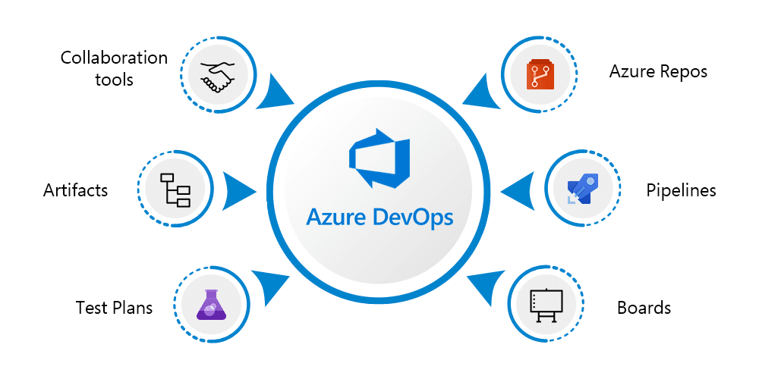
Challenge faced while implementing Learning 1
Azure DevOps was a new platform to me. So immediate exposure to Azure was challenging to me but by the end of the session, I got comfortable with it.

Slide 13
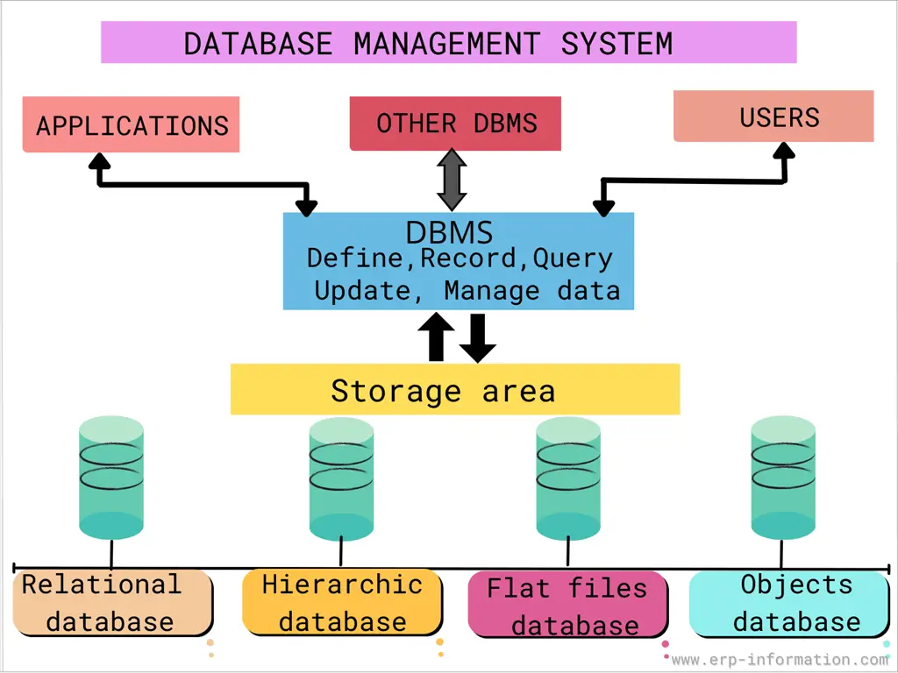
Challenge faced while implementing Learning 2
Some additional concepts in DBMS were taught, it was fun to learn.

Slide 14
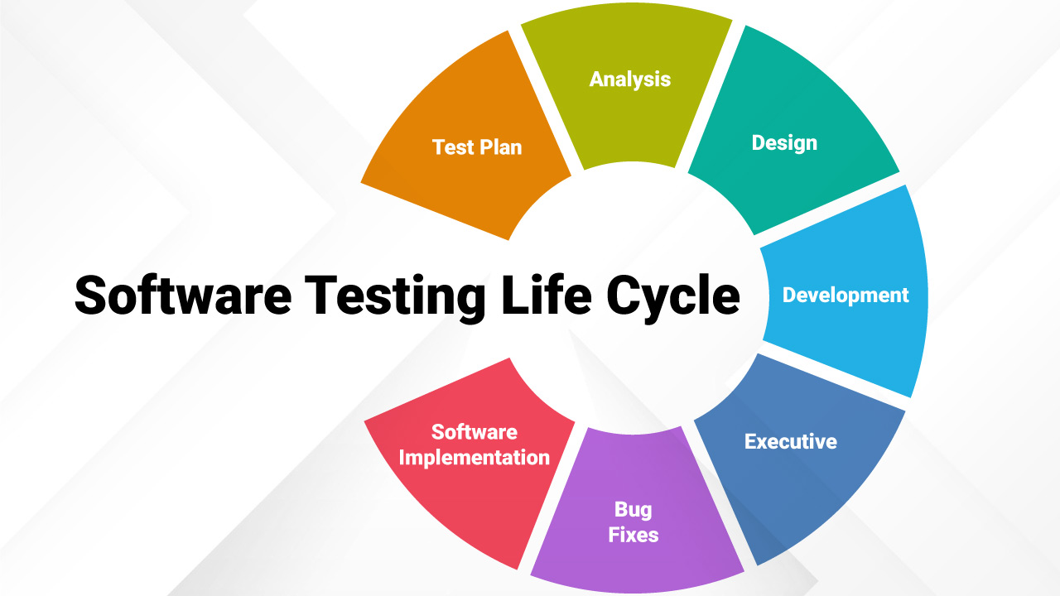
Challenge faced while implementing Learning 3
Hands-on sessions were fun yet a bit challenging sometimes as fitnesse tool was not compatible with java 11+ version. So, setting it up was a little challenging.

Slide 15

Action Plan

Slide 16
My Action Plan for this Week
Actions
Timeline
Status
Revise the basics of DBMS and doing more hands-on cloud computing projects
Within one week
Already started learning

Slide 17

Learning is also Fun!

Slide 18
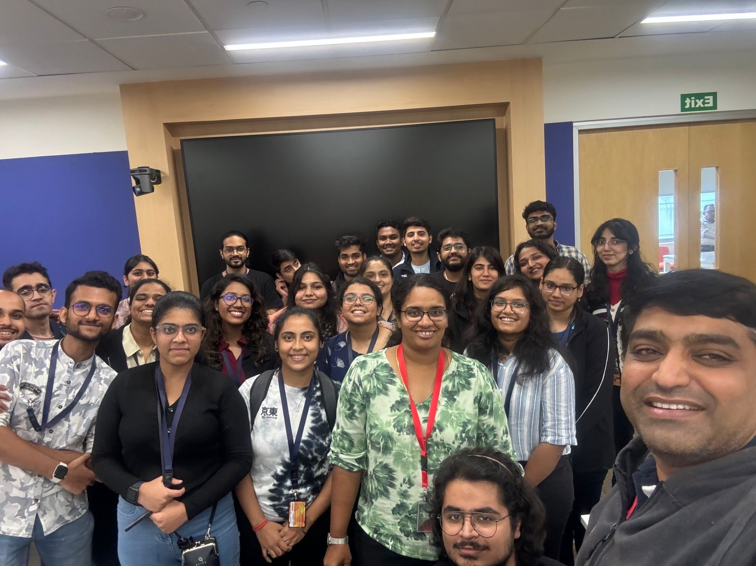
Learning is also Fun!
There were many activities included in learning and it was a real fun experience learning this way. Our trainer taught us about fundamentals of technologies by practical games and the whole session was interactive.

Slide 19

Summary
Integrating methodologies like Agile, Scrum, and DevOps ensures efficient project management and high-quality software delivery.
These approaches foster better collaboration and adaptability, allowing teams to respond quickly to changes and stakeholder needs.
A robust DBMS supports efficient data management and scalability, ensuring data integrity as the organization grows.
Regular testing (STLC) and continuous integration (DevOps) help identify and mitigate risks early, reducing the likelihood of costly errors and ensuring smoother project execution.

Slide 20
Thank You

